Slide 1

Azure Synapse Analytics:
Data Lakehouse
Bringing together data integration, enterprise data warehousing, and big data analytics

Slide 2
Vision - Data Lakehouse
Data Warehouse
Data Lake
Data Lakehouse
Schema on write
Schema on read
Best of both
Cleansed data
Predefined data structures
Easy to query
Hard to load
Retain all data
Support all types of data
Enable real time data
Hard to query
Easy to load
Retain all data
Support all types of data
Enable real time data
Hard to query
Easy to load

Slide 3
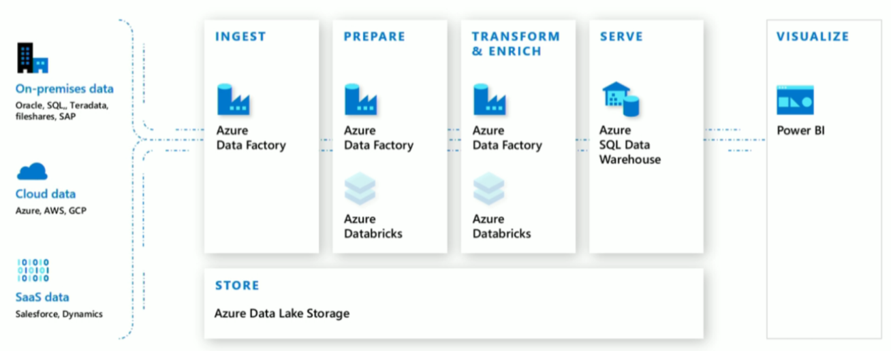
Modern Datawarehouse V1
Azure Synapse Analytics
Notes:
ADF for data ingestion
Data factory for data analysis
Power BI for visualization
Azure synapse - one pane of glass for all tools
Purview for data catalog

Slide 4
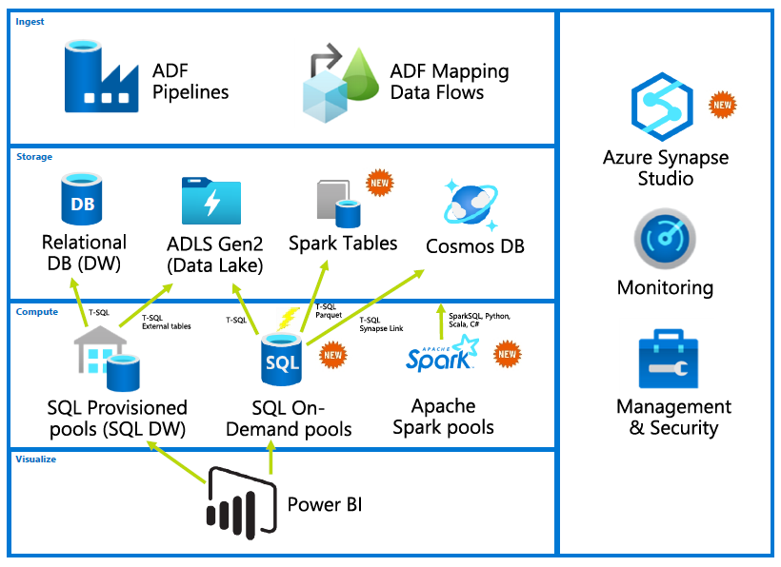
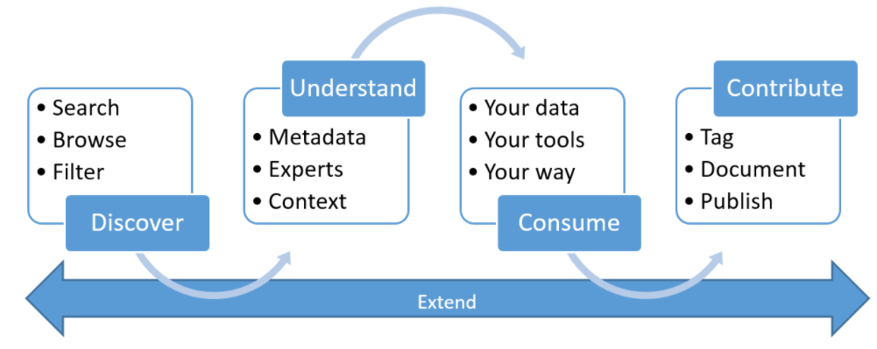
Azure Synapse
Azure Purview
Notes:
Sql serverless – query parquet files as if they are sql tables – query, join, views, update etc. Only pay per query time
Spark pools – start cluster, only pay when it is running.
Regular sql SMP databases
MPP Azure synapse data warehouse

Slide 5
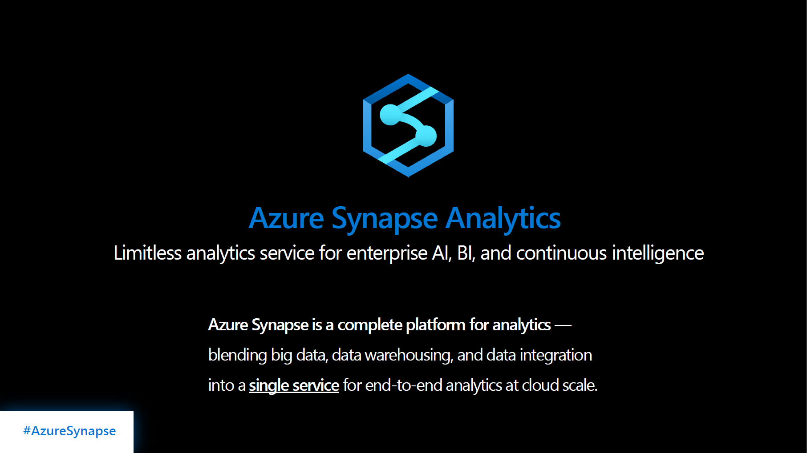
Azure marketing slide #1

Slide 6
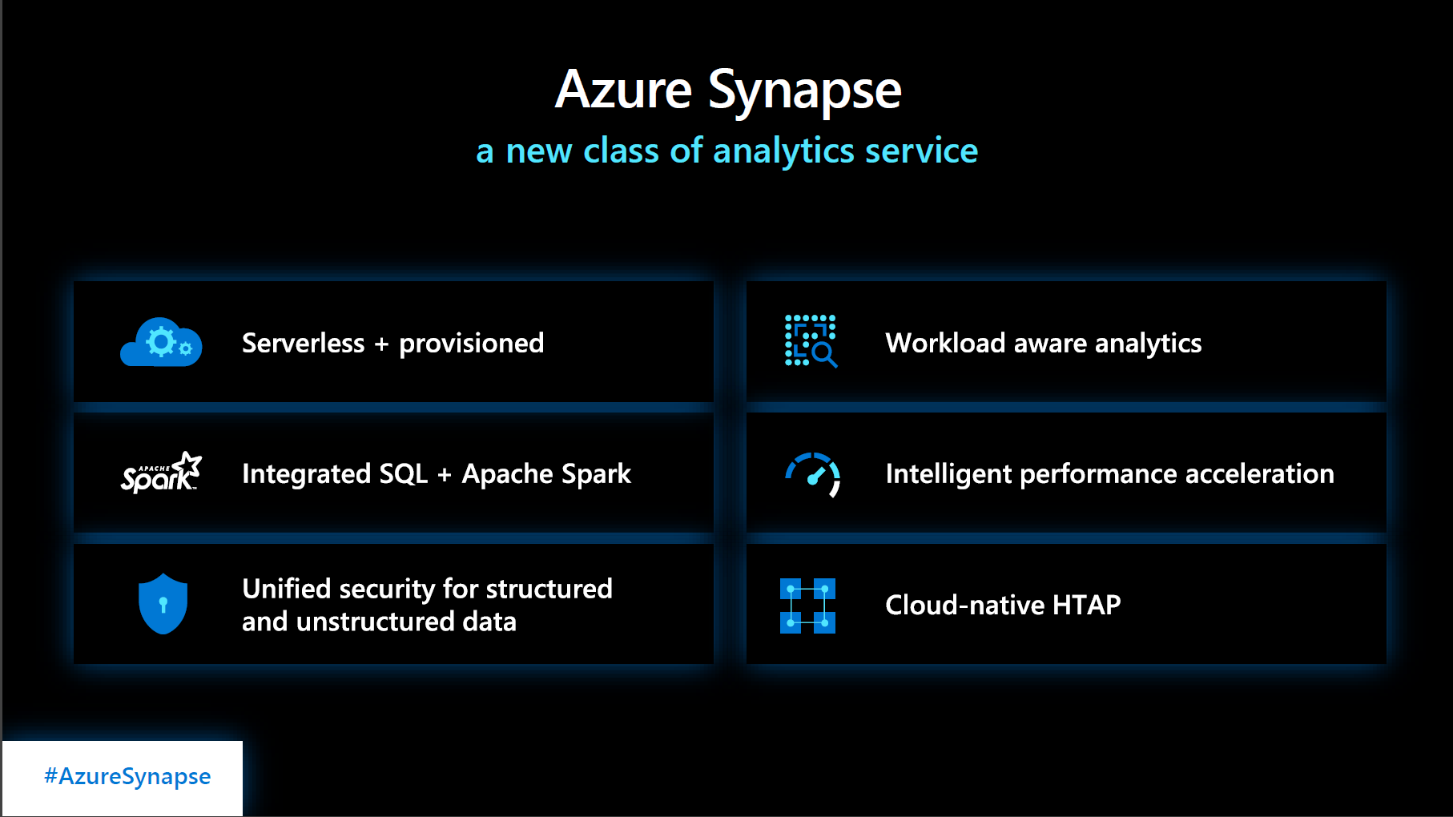
Azure marketing slide #2

Slide 7
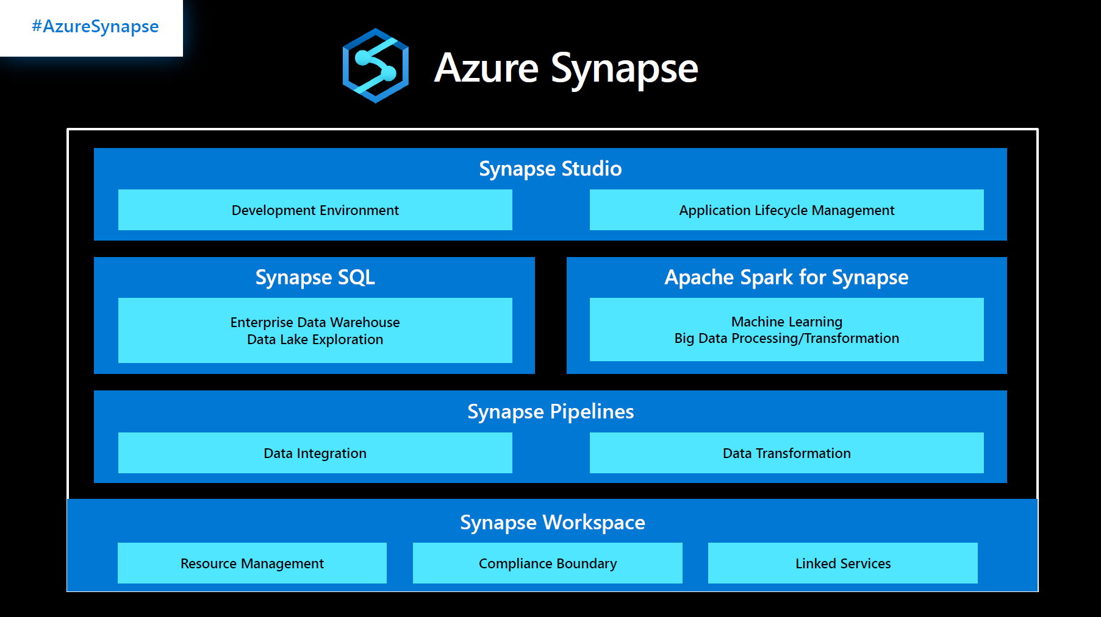
Azure marketing slide #3

Slide 8
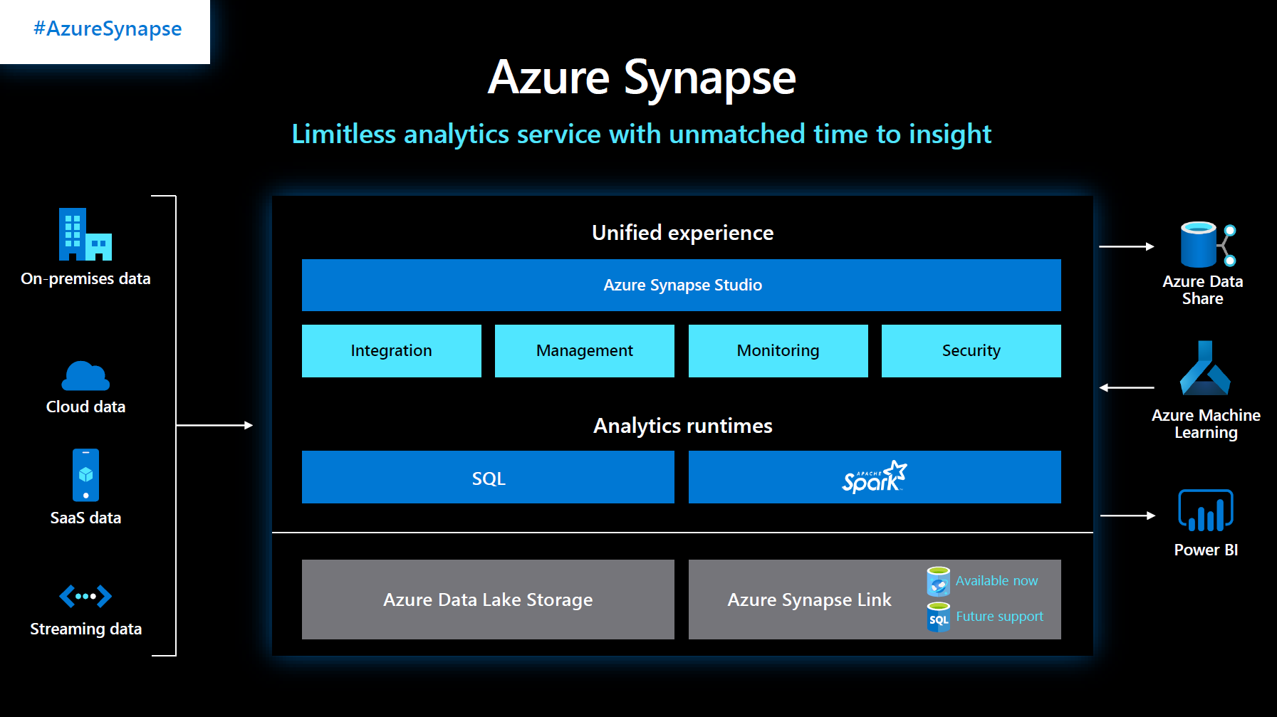
Azure marketing slide #4

Slide 9
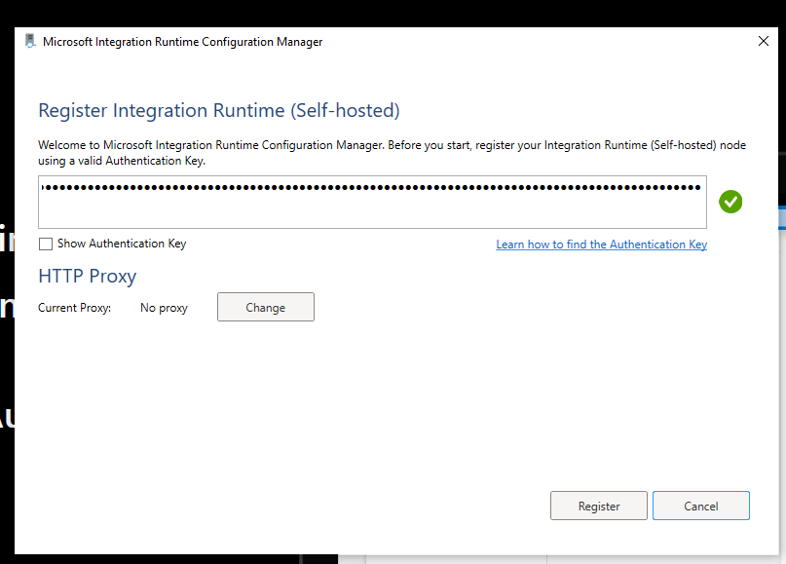
Self Hosted Integration runtime

Slide 10

Thanks!
Jamey Johnston
@STATCowboy
STATCowboy.com
STATCowboy on YouTube
(I have one video on Power BI but it’s a GOOD INTRO ONE!)
https://github.com/STATCowboy

